Slide 1
Stitches. Ouch.
Stitch. A multi-brand design system for Gap inc.

Slide 2
How many teams Gap have
building their own front-ends and repos?

Slide 3
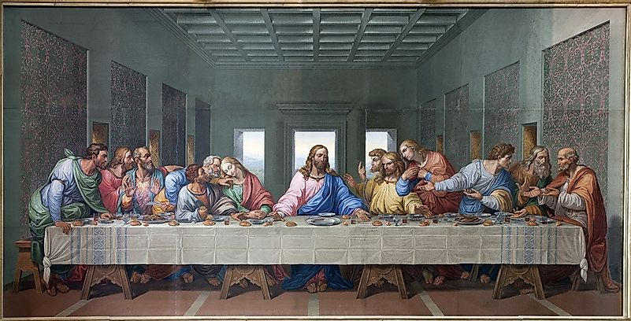
Twelve!
one for each brand, factory brand, MFE.

Slide 4

And Designers…
use different tools that Stitch is not supporting.

Slide 5
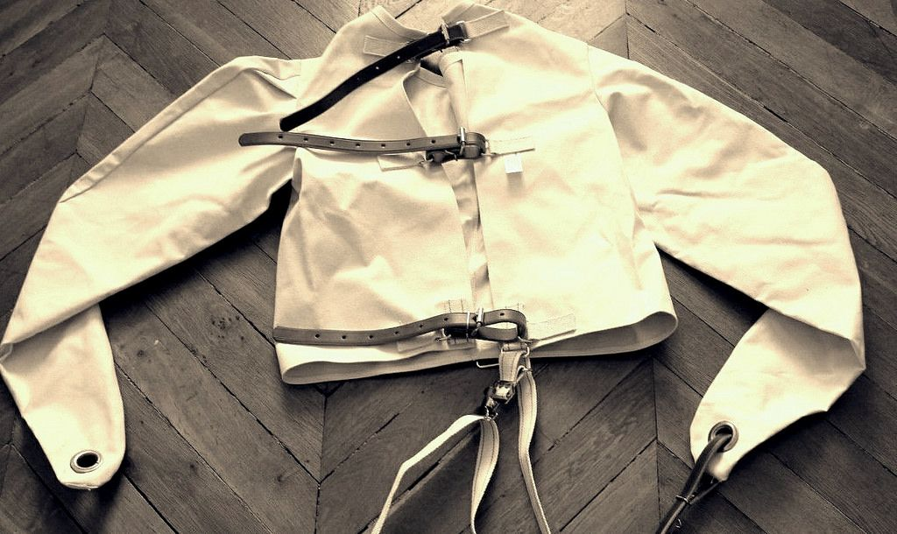
“…Brands hate Stitch!”
They felt policed by an agent put in place to restrict.

Slide 6
Sketch! Bless you.
Adoption rate for the sketch libraries was fairly low, around 50% among central UX and less than 10% for brands.
Deltas between core-ui and libraries are big. Naming, patterns and documentation differed vastly from team to team.
No contribution pipeline was in place except for informal requests via PdMs.

Slide 7

Meet Rishi.
He’s designing for Athleta, in Photoshop, new content for a homepage carousel. He crawls the website and notices that there are seven carousels with slightly different features.
He timidly looks into the Sketch library and notices no carousels are available.
Handing off the new designs he gets blocked by dev. That carousel component is not compatible with the page.

Slide 8
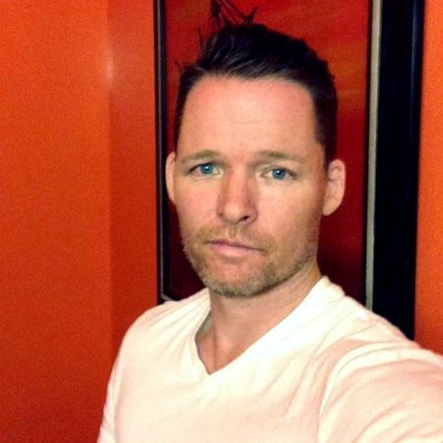
Meet Leif.
He needs to build a new slider for the homepage but he needs to guess motion and accessibility affordances.
He finds an example in Storybook that can be retrofitted, but dependencies seem outdated.
He gets blocked by central UX because designs are not using updated components.

Slide 9

An informational gap* has prevented devs and designers from delivering their solution.
*pun intended

Slide 10
Stitch Design System has same componentry
ACROSS BRANDS AND TEAMS
including documentation and support.

Slide 11
Raise adoption rates without compromising maintenance efficiency

Slide 12
Approach
Balance between adoption and maintenance due to unknown future support.
Simplify Ecosystem by consolidating platforms, naming, access to documentation.

Slide 13
From 8 to 5 library files
WIP and Production live libs
Stitch+Brand -> eStitch+Master Lib-Brand -> Brand
“Figma-ready” Sketch libs
Stitch documentation = specs
Simplify Ecosystem

Slide 14

Approach
Balance between adoption and maintenance due to unknown future support.
Simplify Ecosystem by consolidating platforms, naming, access to documentation.
Leverage key moments in team’s tools evolutions and cyclical variations of workload.

Slide 15
Aug 2019
Sept 2020
Feb 2021
Nov 2019
Oct 2019
Feb 2021
Dec 2021
Leverage Key Moments
Library gets audited
CMS for AT
Figma Kicks in w/
new libs
Code Freeze
Team interviews
Sketch libraries in parity
Documentation shows
in figma

Slide 16
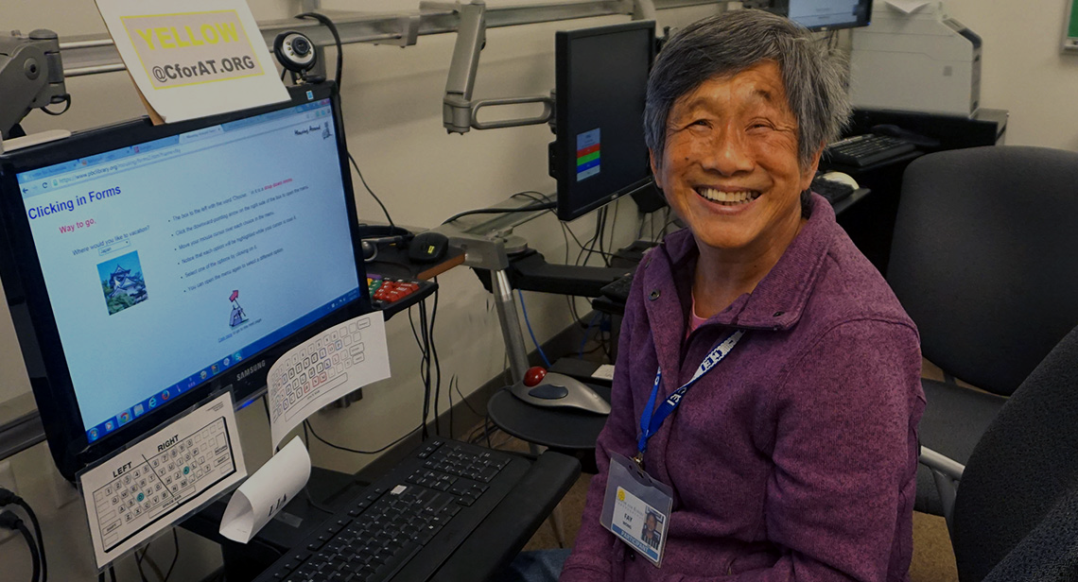
Approach
Balance between adoption and maintenance due to unknown future support.
Simplify Ecosystem by consolidating platforms, naming, access to documentation.
Leverage key moments in team’s tools evolutions and seasonal variations of workload.
Unconditional support for designers and developers in organic activities and ticketed events.

Slide 17
Specialized Channels
Center For Accessible Technology - CforAT
CMS Content types and support
Unconditional Support

Slide 18

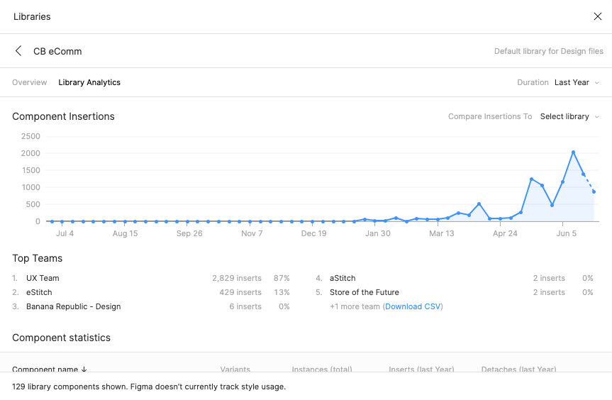

Slide 19
From Stickersheets to Figma components.
Stitch has now 90% component name and pattern parity with the codebase

Slide 20
Stitch onboards new hires and trains designers
At any stage of their tenure, online and via regular workshops and share-outs.

Slide 21
One Stop Documentation
Based on hub and spoke model the Figma documentation page contains both specifications and library instances - so it’s updated in real time.

Slide 22


